Slide 1

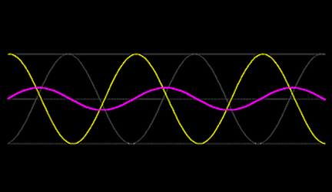
ALTERNATING CURRENT

Slide 2
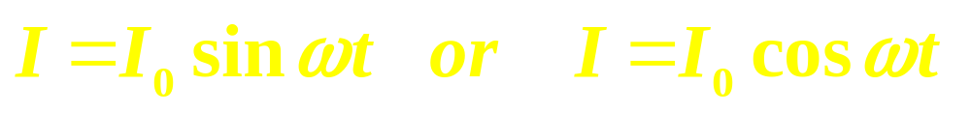
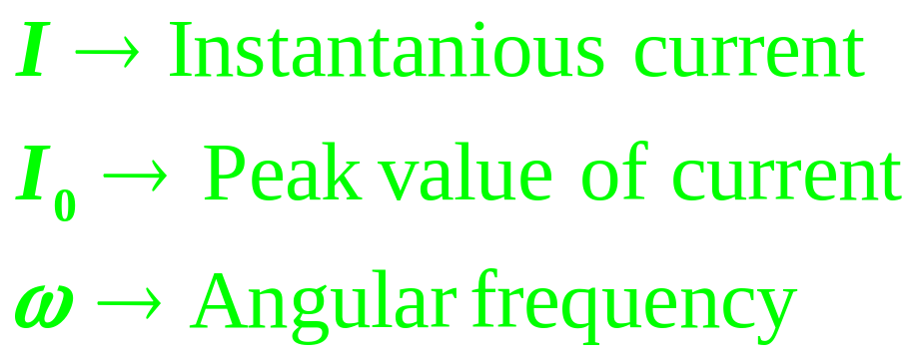
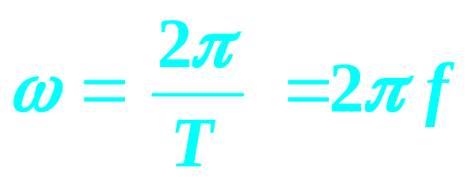
ALTERNATING CURRENT AND VOLTAGE
Voltage or current is said to be alternating if it changes continuously in magnitude and periodically in direction.
It can be represented by a sine curve or cosine curve

Slide 3
I = I₀ sin ωt
I
0
π/2
π
3π/2
2π
t
T/4
T/2
3T/4
T

Slide 4
Condition required for current/ voltage to be Alternating
Amplitude is constant.
Alternate half cycle is positive and successive half will be negative.
The alternating current continuously varies in magnitude and periodically reverses its direction.

Slide 5
Root Mean Square of AC
Root Mean Square (rms) value of alternating current is that steady current which would produce the same heat in a given resistance in a given time as is produced by the given alternating current in the same resistance in the same time.
If nothing is mentioned then values printed in a.c circuit on electrical appliances, any given or unknown values, reading of AC meters are assumed to be RMS.

Slide 6
Class Assignment
The r.m.s value of alternating current is
1. Double of peak value 2. Half of pea value
3. times of peak value 4. Equal to peak value
2. The r.m.s value of alternating current is 10 amp. Having frequency of 50 Hz. The time taken by the current to increase from zero to maximum and the maximum value of current will be
1. 2 x 10⁻² s and 14.14 amp 2. 1 x 10⁻² s and 7.0 amp
3. 5 x 10⁻³ s and 7.07 amp 4. 5 x 10⁻³ s and 14.14 amp

Slide 7
3. In ac circuit when ac ammeter is connected it reads I current if a student uses dc ammeter in place of ac ammeter the reading in the dc ammeter will be
1. 2. 3. 0.637 I 4. zero
In an AC generator, a coil with N turns, all of the same area A and total resistance R, rotates with frequency ω in a magnetic field B. The maximum value of emf generated in the coil is
1. N.A.B.R 2. N.A.B.ω 3. N.A.B.R.ω 4. N.A.B.

Slide 8



Phasor and Phasor diagram – Graphical Representation
y
y
E
I₀
E₀
I
$$φ$$
ωt
0
x
π/2
π
3π/2
2π

Slide 9


AC Circuits
1. Resistor only Circuit
R
$$E=E_{0} sin ωt$$
I = E / R
= (E₀ / R) sin ωt
E = E₀ sin ωt
I = I₀ sin ωt
(where I₀ = E₀/R and R = E₀/I₀)
$(φ=0$)
Emf and current are in same phase.
y
y
E
I₀
E₀
I
ωt
0
x
π/2
π
3π/2
2π

Slide 10



2. Inductor only Circuit
L
E = E₀ sin ωt
$(φ=\text{π}\text{/2}$)
Current lags behind emf by π/2 rad.
y
y
E
E₀
ωt
0
x
π/2
π/2
π
3π/2
2π
I₀
I

Slide 11


3. Capacitor only Circuit
C
E = E₀ sin ωt
Current leads the emf by a phase difference of π/2 rad.
$(φ=\text{π}\text{/2}$)
y
y
E
I₀
I
E₀
π/2
ωt
0
x
π/2
π
3π/2
2π

Slide 12
Variation of X_{L} with Frequency:
X_{L}
I₀ = E₀ / ωL and X_{L} = ωL
X_{L} is Inductive Reactance and ω = 2π f
X_{L} = 2π f L i.e. X_{L} α f
0
f
Variation of X_{C} with Frequency:
X_{C}
I₀ = E₀ / (1/ωC) and X_{C} = 1 / ωC
X_{C} is Inductive Reactance and ω = 2π f
X_{C} = 1 / 2π f C i.e. X_{C} α 1 / f
0
f
TIPS:
Inductance (L) can not decrease Direct Current. It can only decrease Alternating Current.
Capacitance (C) allows AC to flow through it but blocks DC.

Slide 13
Series L C R Circuit:
L
C
R
V_{L}
V_{R}
V_{C}
E = E₀ sin ωt
The applied emf appears as Voltage drops V_{R}, V_{L} and V_{C} across R, L and C respectively.
In R, current and voltage are in phase.
In L, current lags behind voltage by π/2, or V_{L} leads the current I_{L} by π/2
In C, current leads the voltage by π/2, or V_{c} lags the current I_{c} by π/2

Slide 14

Phasor Diagram
B
V_{R}
y
y
V_{L} - Vc
V_{R}
V_{Z}
A
V_{L} - Vc
$$φ$$
V_{R}
V_{L}
ωt
ωt
0
x
0
x
π/2
Vc

Slide 15

Impedance Triangle
B
R
y
X_{L} - Xc
Z
A
XXX_{L} - Xc
$$φ$$
R
ωt
0
x
Type this content here,
text page no:94

Slide 16
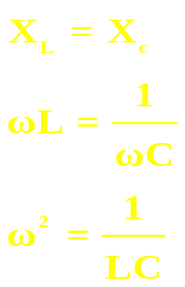
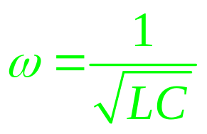
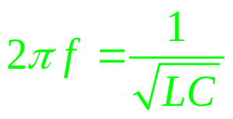
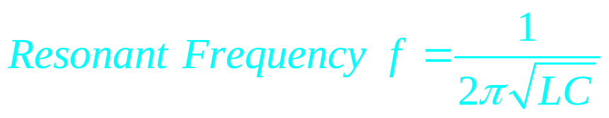
X_{c}
X_{L}
R
Capacitive
Resistivee
Inductive
0
X_{c}>X_{L}
X_{L} =X_{c}
X_{L} >X_{c}
f
At resonance X_{L} =X_{c,} impedance will be minimum, the current will be maximum in the circuit.

Slide 17
Resonant Curve & Q - Factor:
Band width = 2 ∆ ω
Quality factor (Q – factor) is defined as the ratio of resonant frequency to band width.
I₀
I_{0max}
R₁ < R₂ < R₃
Q = ω_{r} / 2 ∆ ω
I_{0max} / √2
R₁
It can also be defined as the ratio of potential drop across either the inductance or the capacitance to the potential drop across the resistance.
R₂
R₃
Q = V_{L} / V_{R}
or Q = V_{C} / V_{R}
0
ω_{r}
ω
ω_{r} - ∆ ω
or Q = ω_{r} L / R
or Q = 1 / ω_{r}CR
ω_{r} + ∆ ω

Slide 18
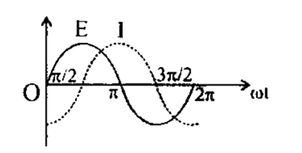
The variation of the instantaneous current I and the instantaneous emf E in a circuit is as shown in fig.
Which of the following statements is correct.
1. the voltage lags behind the current by π/2
2. the voltage leads the current by π/2
3. the voltage and the current are in phase
4. the voltage leads the current by π

Slide 19
If an inductive circuit equation of A.C., is I = i₀ sin ωt then:
1. E = E₀sin 2. E = E₀sin
3. E = E₀sin ωt 4. None of the above
A coil has reactance of 100Ω. When frequency is 50Hz. If the frequency becomes 150 Hz., then the reactance will be:
1. 100Ω 2. 300Ω 3. 450Ω 4. 600Ω
An alternating voltage E = 200 sin (100 t) volt is connected to a 1µ F capacitor through an A.C. ammeter. The reading of ammeter is:
1. 10 mA 2. 20 mA 3. 40 mA 4. 80 mA

Slide 20
9. In the condition of resonance what is the value of frequency in Hz. When C = 1µF and L = 1µH:
1. 10⁶ 2. 3. 2µ x 10⁻⁶ 4. 2π x 10⁶
10. In a circuit the frequency is f = Hz and the inductance is 2 henry, then the reactance will be
1. 200 Ω 2. 200 µΩ 3. 2000 µΩ 4. 2000 µΩ
11. In pure inductance the current is:
1. Leading, potential by 2. Lagging, potential by
3. in same phase with potential
4. With a phase difference of π with potential

Slide 21
12. Phase of current in LCR circuit:
1. Is in the phase of potential
2. Leading from the phase of potential
3. Lagging from the phase of potential
4. Before resonance frequency, leading from the phase of potential and after resonance frequency, lagging from the phase of potential
13. In a circuit having a resistance of 100 Ω connected is series with a capacitive reactance of 100 Ω to an alternating voltage source, the current:
1. Leads voltage by 90° 2. Leads voltage by 45°
3. Lags behind voltage by 90° 4. Lags behind voltage by 45°

Slide 22
12. In an A.C. circuit inductance, capacitance and resistance are connected. If the effective voltage across inductance is V_{L}, across capacitance is V_{C} and across resistance is V_{R}, then the total effective value of voltage is:
1. V_{R}+V_{L}+V_{C} 2. V_{R}+V_{L}-V_{C} 3. 4.
13. Which one of the following has not the same unit
1. 2. 3. RC 4.
14. Which of the following statements is correct, of an LCR series combination having the resonating condition as:
1. the current is minimum
2. The phase difference between the current an e.m.f is
3. the impedance is equal to R
4. the value of power factor is minimum

Slide 23
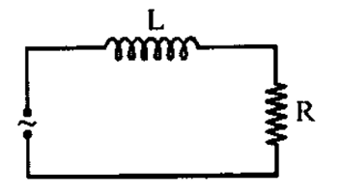
15. A bulb and a capacitor are connected in series to a source of alternating current. If its frequency is increased, while keeping the voltage of the source constant, then
1. Bulb will give more intense light
2. Bulb will give less intense light
3. Bulb will give light of same intensity as before
4. Bulb will stop radiating light
16. An inductor and a resistor in series are connected to an A.C. supply of variable frequency. As the frequency of the source is increased, the phase angle between current and the potential difference across source will be:
1. First increase and then decrease 2. First decrease and then increase
3. Go on decreasing 4. Go on increasing

Slide 24
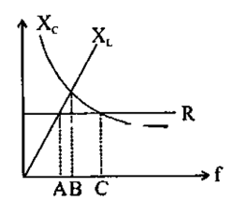
17. If the current through an inductor of inductance I, is given by I = I₀sin ωt then the voltage across inductor will be:
1. I₀ ω L sin 2. I₀ ω L sin
3. I₀ ω L sin (ωt - π) 4. None of these
18. The power factor of L-R circuit is
1. 2. 3. ω LR 4.
19. The figure shows variation of R, X_{L} and X_{c} with frequency f in a series L, C, R circuit. Then for what frequency point, the circuit is inductive
1. A 2. B 3. C 4. All points

Slide 25
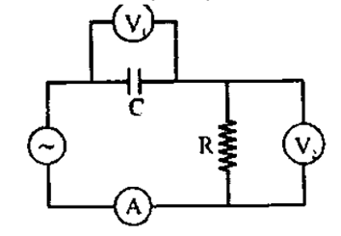
20. The diagram shows a capacitor C and a resistor R connected in series to an AC source, V₁ and V₂ are voltmeters and A is an ammeter. Consider now the following statement:
i. Readings in A and V₂ are always in phase
ii. Reading in V₁ is ahead with reading in V₂
iii. Readings in A and V₁ are always in phase
1. (i) only 2. (ii) only 3. (i) and (ii) only 4. (ii) and (iii) only

Slide 26
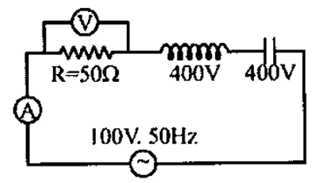
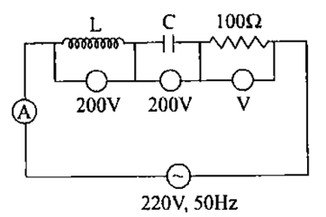
21. In given LCR circuit the voltage across the terminals of a resistance and current will be
1. 400V, 2A 2. 800V, 2A 3. 100V, 2A 4. 100V, 4A
22. The readings of ammeter and voltmeter in the following circuit respectively
1. 2A, 200V 2. 1.5A, 100V 3. 2.7A, 220V 4. 2.2A, 220V

Slide 27
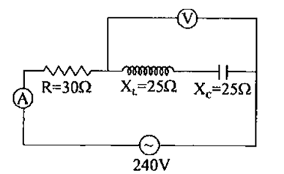
23. In the circuit shown in figure neglecting source resistance the voltmeter and ammeter reading will respectively be
1. 0V, 3A 2. 150V, 3A 3. 150V, 6A 4. 0V, 8A
24. The hot wire ammeter measures:
1. Only D.C. current 2. Only A.C. current
3. None of above 4. Both AC and DC
25. A circuit has three elements, a resistance of 11Ω a coil of inductive reactance 120Ω and a capacitive reactance of 120Ω in series and connected to an A.C. source of 110V, 60Hz. Which of the three elements have minimum potential difference?
1. Resistance 2. Capacitance 3. Inductor
4. All will have equal potential difference

Slide 28
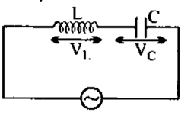

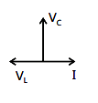
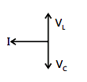

26. The current I, potential difference V_{L} across the inductor and potential difference V_{C} across the capacitor in circuit as shown in the figure are best represented vectorially as
1. 2.
3. 4.

Slide 29
POWER IN AC CIRCUITS
E = E₀ sin ωt
I = I₀ sin (ωt + Φ)(where Φ is the phase angle between emf and current)
Instantaneous Power = E I
= E₀ I₀ sin ωt sin (ωt + Φ)
= E₀ I₀ [sin² ωt cosΦ + sin ωt cosωt cosΦ]
If the instantaneous power is assumed to be constant for an infinitesimally small time dt, then the work done is dW = E₀ I₀ [sin² ωt cosΦ + sin ωt cosωt cosΦ]

Slide 30
Work done over a complete cycle is
T
W = ∫ E₀ I₀ [sin² ωt cosΦ + sin ωt cosωt cosΦ] dt
0
W = E₀I₀ cos Φ x T / 2
Average Power over a cycle is P_{av} = W / t
P_{av} = (E₀I₀/ 2) cos Φ
P_{av} = (E₀/√2) (I₀/ √2) cos Φ
P_{av} = E_{rms} I_{rms} cos Φ
where cos Φ = R/Z
= R /√ [R² + (ω L – 1/ωC)²]
is called Power Factor

Slide 31
P_{av} = E_{v} I_{v} cos Φ
Power in AC Circuit with R:
In R, current and emf are in phase.
Φ = 0°
P_{av} = E_{v} I_{v} cos Φ = E_{v} I_{v} cos 0° = E_{v} I_{v}
Power in AC Circuit with L:
In L, current lags behind emf by π/2.
Φ = - π/2
P_{av} = E_{v} I_{v} cos (-π/2) = E_{v} I_{v} (0) = 0
Power in AC Circuit with C:
In C, current leads emf by π/2.
Φ = + π/2
P_{av} = E_{v} I_{v} cos (π/2) = E_{v} I_{v} (0) = 0
Power (Energy) is not dissipated in Inductor and Capacitor and hence they find a lot of practical applications and in devices using alternating current.

Slide 32
Wattless Current or Idle Current:
E_{v}
I_{v} cos Φ
I_{v}
Φ
90°
I_{v} sin Φ
The component I_{v} cos Φ generates power with E_{v}.
However, the component I_{v} sin Φ does not contribute to power along E_{v} and hence power generated is zero. This component of current is called wattless or idle current.
P = E_{v} I_{v} sin Φ cos 90° = 0

Slide 33
27. The current I=I₀sin is flowing in a variable current circuit. The potential E=E₀sin ωt is applied to the circuit. The loss of power will be:
1. 2. 3. 4. P = zero
28. If a choke coil of negligible resistance works on 220V source and 5mA current is flowing through it, then the loss of power in a choke coil is:
1. Zero 2. 11 watt 3. 44 x 10³ watt 4. 1.1 watt
29. The value of current at half power point is
1. I_{m} 2. 3. 2I_{m} 4.

Slide 34
29. In which of the following case power factor will be negligible
1. Inductance and resistance both high
2. Inductance and resistance both low
3. Low resistance and high inductance
4. High resistance and low inductance
30. In a purely capacitive circuit average power dissipated in the circuit is
1. V_{rms}I_{rms} 2. Depends on capacitance
3. Infinite 4. Zero

Slide 35
TRANSFORMER
Transformer is a device which converts lower alternating voltage at higher current into higher alternating voltage at lower current.
Principle:
Transformer is based on Mutual Induction.
It is the phenomenon of inducing emf in the secondary coil due to change in current in the primary coil and hence the change in magnetic flux in the secondary coil.
P
S
Load

Slide 36
Theory:
E_{P} = - N_{P} dΦ / dt
E_{S} = - N_{S} dΦ / dt
E_{S} / E_{P} = N_{S} / N_{P} = K
(where K is called Transformation Ratio or Turns Ratio)
For an ideal transformer,
Output Power = Input Power
E_{S}I_{S} = E_{P}I_{P}
E_{S} / E_{P} = I_{P} / I_{S}
E_{S} / E_{P} = I_{P} / I_{S} = N_{S} / N_{P}
Efficiency (η):
η = E_{S}I_{S} / E_{P}I_{P}
For an ideal transformer η is 100%

Slide 37
Step - up Transformer:
Step - down Transformer:
P
S
Load
P
S
Load
N_{S} > N_{P} i.e. K > 1
E_{S} > E_{P} & I_{S} < I_{P}
N_{S} < N_{P} i.e. K < 1
E_{S} < E_{P} & I_{S} > I_{P}

Slide 38
ENERGY LOSSES IN A TRANSFORMER:
Copper Loss: Heat is produced due to the resistance of the copper windings of Primary and Secondary coils when current flows through them.
This can be avoided by using thick wires for winding.
Flux Loss: In actual transformer coupling between Primary and Secondary coil is not perfect. So, a certain amount of magnetic flux is wasted.
Linking can be maximized by winding the coils over one another.

Slide 39
Iron Losses:
a) Eddy Currents Losses:
When a changing magnetic flux is linked with the iron core, eddy currents are set up which in turn produce heat and energy is wasted.
Eddy currents are reduced by using laminated core instead of a solid iron block because in laminated core the eddy currents are confined with in the lamination and they do not get added up to produce larger current. In other words their paths are broken instead of continuous ones.
Solid Core
Laminated Core

Slide 40
b) Hysteresis Loss:
When alternating current is passed, the iron core is magnetized and demagnetized repeatedly over the cycles and some energy is being lost in the process.
This can be minimized by using suitable material with thin hysteresis loop.
Losses due to vibration of core: Some electrical energy is lost in the form of mechanical energy due to vibration of the core and humming noise due to magnetostriction effect.

Slide 41
31. What is increased in step – down transformer
1. Voltage 2. Current 3. Power 4. Current density
32. The primary winding of a transformer has 100 turns and its secondary winding has 200 turns. The primary is connected to an ac supply of 120V and the current flowing in it is 10A. The voltage and current in the secondary are
1. 240V, 5A 2. 240V, 10A 3. 60V, 20A 4. 120V, 20A
33. A step-up transformer has transformation ratio of 3:2. What is the voltage in secondary if voltage in primary is 30 V
1. 45V 2. 15V 3. 90V 4. 300V
34. A step-down transformer is connected to main supply 200V to operate a 6V, 30W bulb. The current in primary is
1. 3A 2. 1.5A 3. 0.3A 4. 0.15A

Slide 42
35. An ideal transformer has 500 and 5000 turn in primary and secondary windings respectively. If the primary voltage is connected to a 6V battery then the secondary voltage is
1. 0 2. 60V 3. 0.6V 4. 6.0V
36. Quantity that remains unchanged in a transformer is
1. Voltage 2. Current 3. Frequency 4. None of the above
37. In a transformer, the number of turns in primary and secondary are 500 and 2000 respectively. If current is
1. 12A 2. 24A 3. 48A 4. 144A

Slide 43
THANK YOU

